Slide 1
WNM 617
Wrapping a Site Android Studio

Slide 2
Introduction

Slide 3
Wrapping your site in a Native Container
Beyond using PhoneGap or other hybrid frameworks we can wrap our mobile/responsive websites directly in xCode (either using Objective C or Swift) or Android using WebViews

Slide 4
Pros and Cons
Pros
Cons
Like hybrid app frameworks your HTML, CSS, and JavaScript is cross compatible
Speed of development and design
Like hybrid app frameworks, it is easier to push out updates
Restricted or Experimental access to native hardware (camera, etc…)
Performance and speed of app can be hindered
If your web app is hosted on a server it will require an internet connection
Apple may deny your app in the store if it doesn’t take “enough” advantage of device hardware or native technologies. No one really knows what “enough” is.

Slide 5
So Why Choose This?
If your project doesn’t require extremely high performance
If your project needs to be cross compatible with other device
If you don’t have the time to learn Swift or Java to create a native app

Slide 6
Demo with Android Studio

Slide 7
Steps
Open Android Studio
If you are doing this on your own laptop you will need to install the Java SDK 7 (if not already installed) and Android Studio

Slide 8
Steps
Click “Start a New Android Studio Project”
Give the project a name and it is ok to leave the default values for other fields

Slide 9
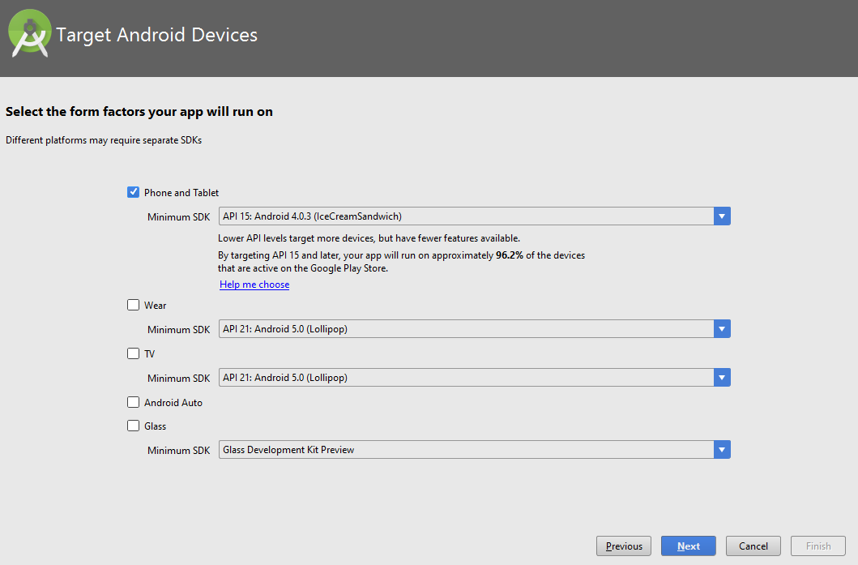
Steps
In the “Select a Form Factor your app will run on” make sure Phone/Tablet is selected

Slide 10
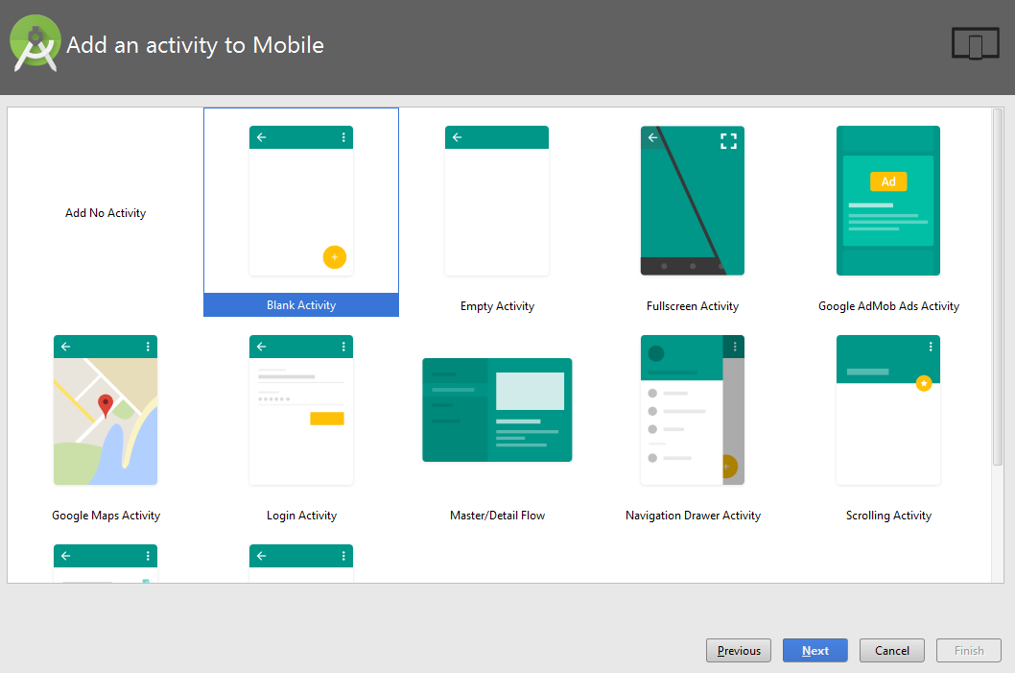
Steps
In “Add Activity to Mobile” select Blank Activity and click next

Slide 11
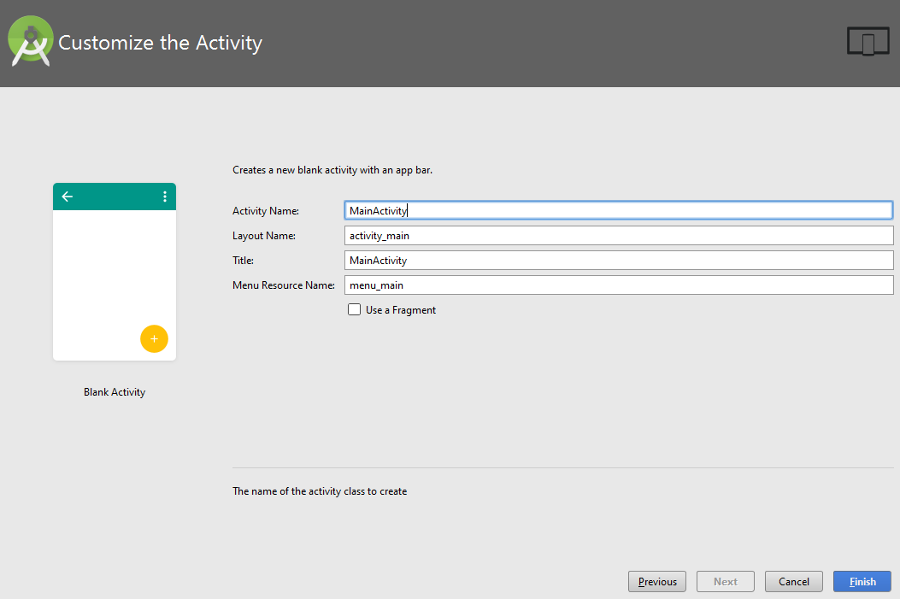
Steps
In the “Customize Activity Window” Leave the defaults, click Finish

Slide 12
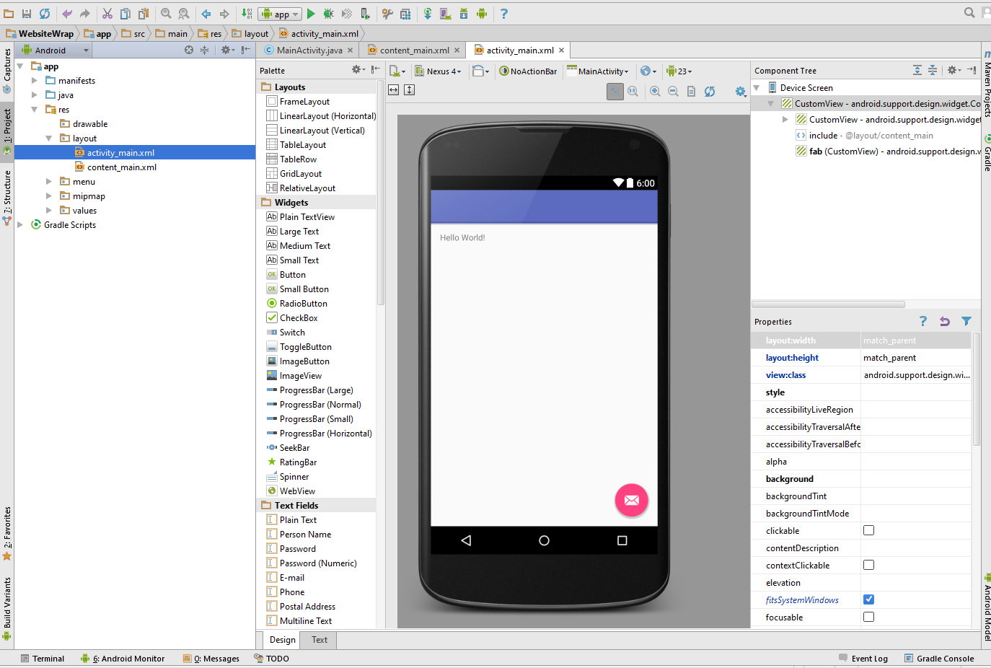
Steps
Once Android Studio is up again double click activity_main.xml
Remove the Hello World, Main Icon, and Toolbar by right clicking and selecting Delete

Slide 13
Steps
In the Text View make your code look like the code provided on the class website
In Java > com.*.* > Main Activity make the code look like the code provided on the class website
Note that the load remote website area. This is where you place your URL
Open manifest.xml under add <uses-permission android:name="android.permission.INTERNET" /> under </application>

Slide 14

Skip
Click on the nreen play button in the toolbar of Android Studio.
Select All of the defaults in any windows that come up.
Your application should launch in the Android Emulator loading your website (the emulator may take a second to load)

Slide 15
Videos Coming
I will add videos of how to do a navigation bar in iOS this week. Pay attention to the class facebook group for a notification.

Slide 16
Activity
Work on your Final Project

